Slide 1



Presented By :Vanshika Jaiswal BBA-BA33
A Data-Driven Journey into A Data-Driven Journey into Personalized Entertainment

Slide 2

Netflix – world’s largest OTT platform with 301M+ subscribers.
Streaming in 80+ countries with 95B+ hours watched (2025).
Offers diverse content — movies, TV shows, documentaries, reality series.
Uses advanced AI & analytics for user engagement.
This project applies clustering to group similar shows.
Goal – make recommendations smarter and improve user retention.

Slide 3

About Netflix
Founded in 1997 by Reed Hastings & Marc Randolph as DVD rental.
Shifted to streaming in 2007 → global leader today.
Produces Netflix Originals — Stranger Things, Wednesday, Squid Game, Money Heist.
Available in 190+ countries with localized content.
Focuses on AI-driven personalization, regional pricing, and interactive content.

Slide 4
Problem Statement
Netflix needs to keep viewers engaged to reduce churn.
It hosts thousands of titles across different genres & countries.
Challenge: How to group similar shows automatically?
Solution: Use clustering algorithms to group shows based on similarity.
Output: Better personalized recommendations for users.

Slide 5
Project Objectives
Analyze Netflix dataset (6,234 titles).
Identify patterns in content — type, genre, country, release year.
Apply machine learning clustering to group similar shows.
Understand trends that influence viewer preferences.
Improve recommendation quality using clusters.

Slide 6
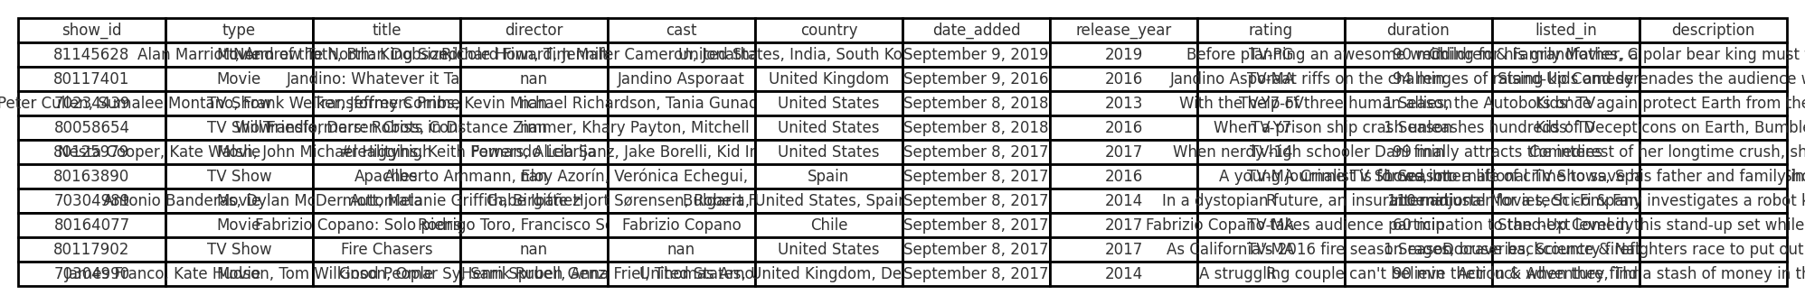
Dataset Overview
Source: Netflix Titles Dataset
Size: 6,234 records
Features: show_id, title, type, director, cast, country, release_year, rating, duration, listed_in, description
Type: Categorical + Text data
Scope: Global (titles from 80+ countries)

Slide 7
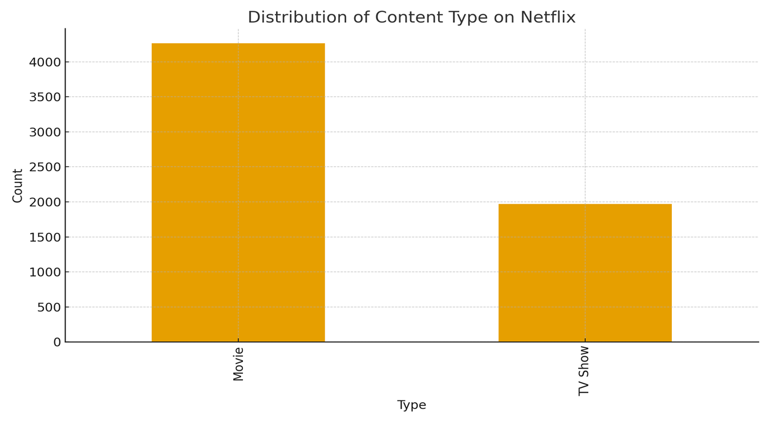
Content Type Distribution
Netflix library majorly includes Movies and TV Shows.
Movies form around 70% of total titles.
TV Shows growing rapidly with regional productions

Slide 8
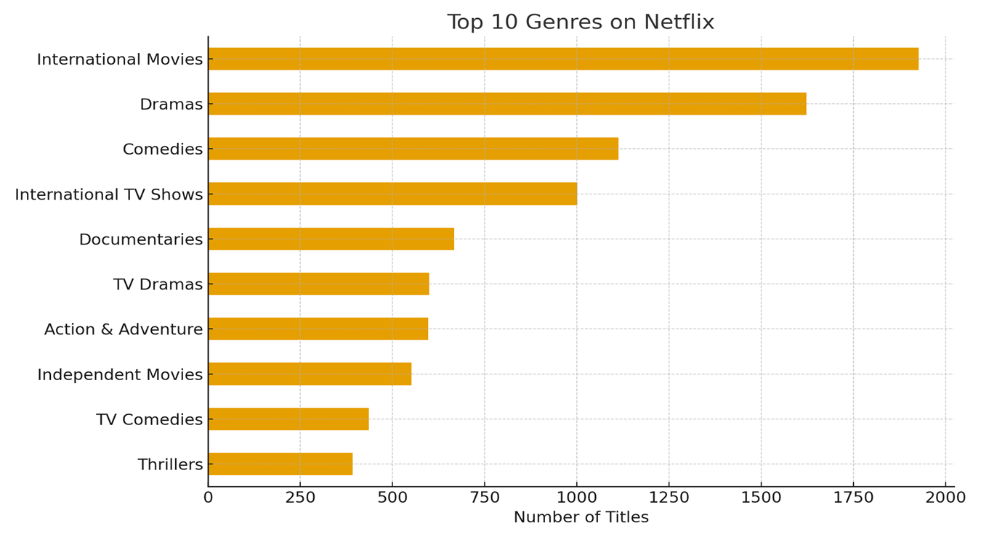
Top 10 Genres
Dominant genres include Drama, Comedy, Action, Documentary, and Thriller.
Comedy & Drama appear in most countries.
Diverse genres cater to all age groups.

Slide 9
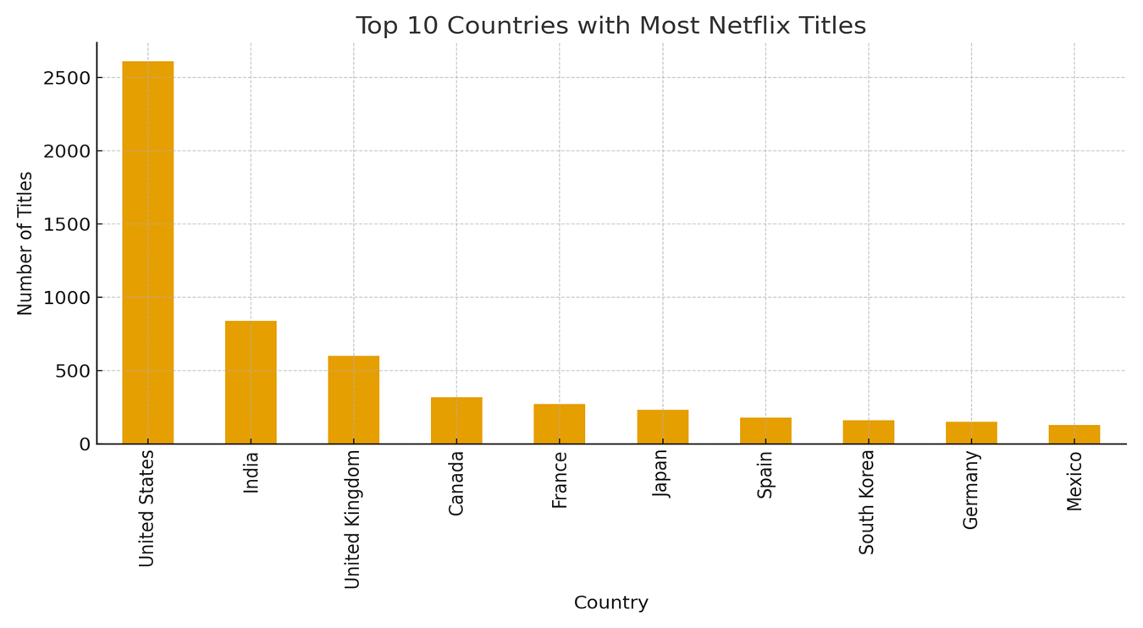
Top 10 Countries
Highest number of titles:
United States
India
United Kingdom
Canada
Japan
South Korea
Spain
France
Brazil
Australia

Slide 10
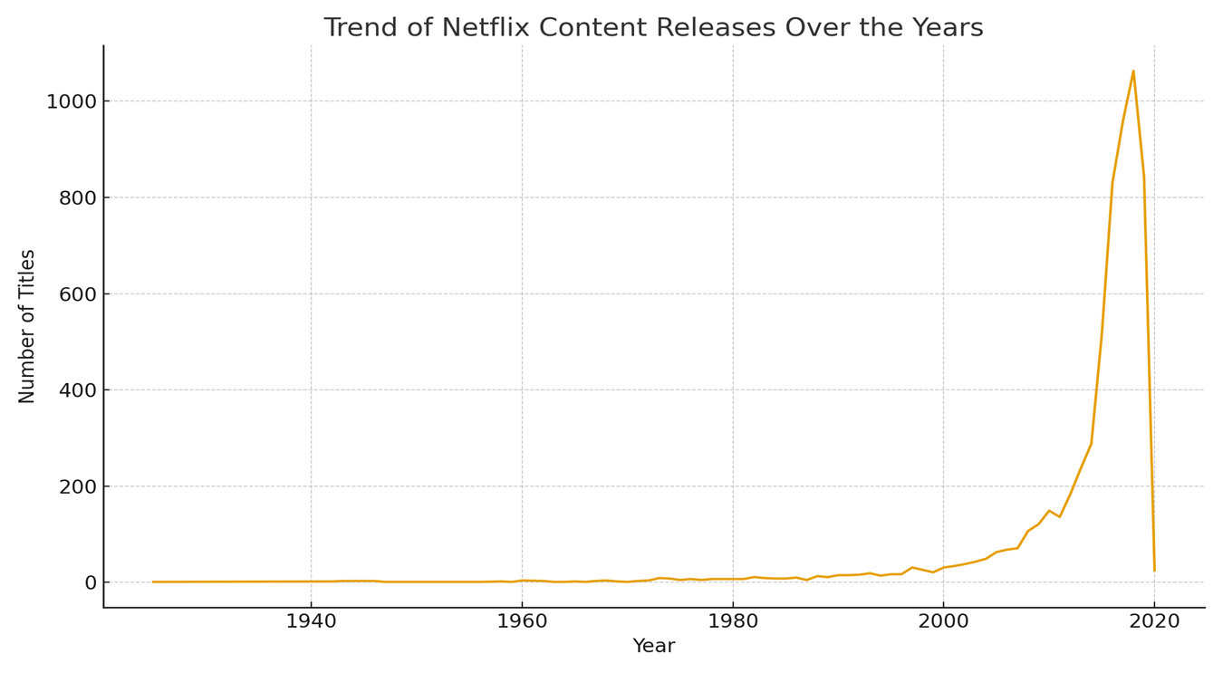
Trend Over the Years
Netflix content increased sharply post-2015.
Reflects company’s global expansion and original productions.
Streaming boom during 2020 (pandemic period).

Slide 11
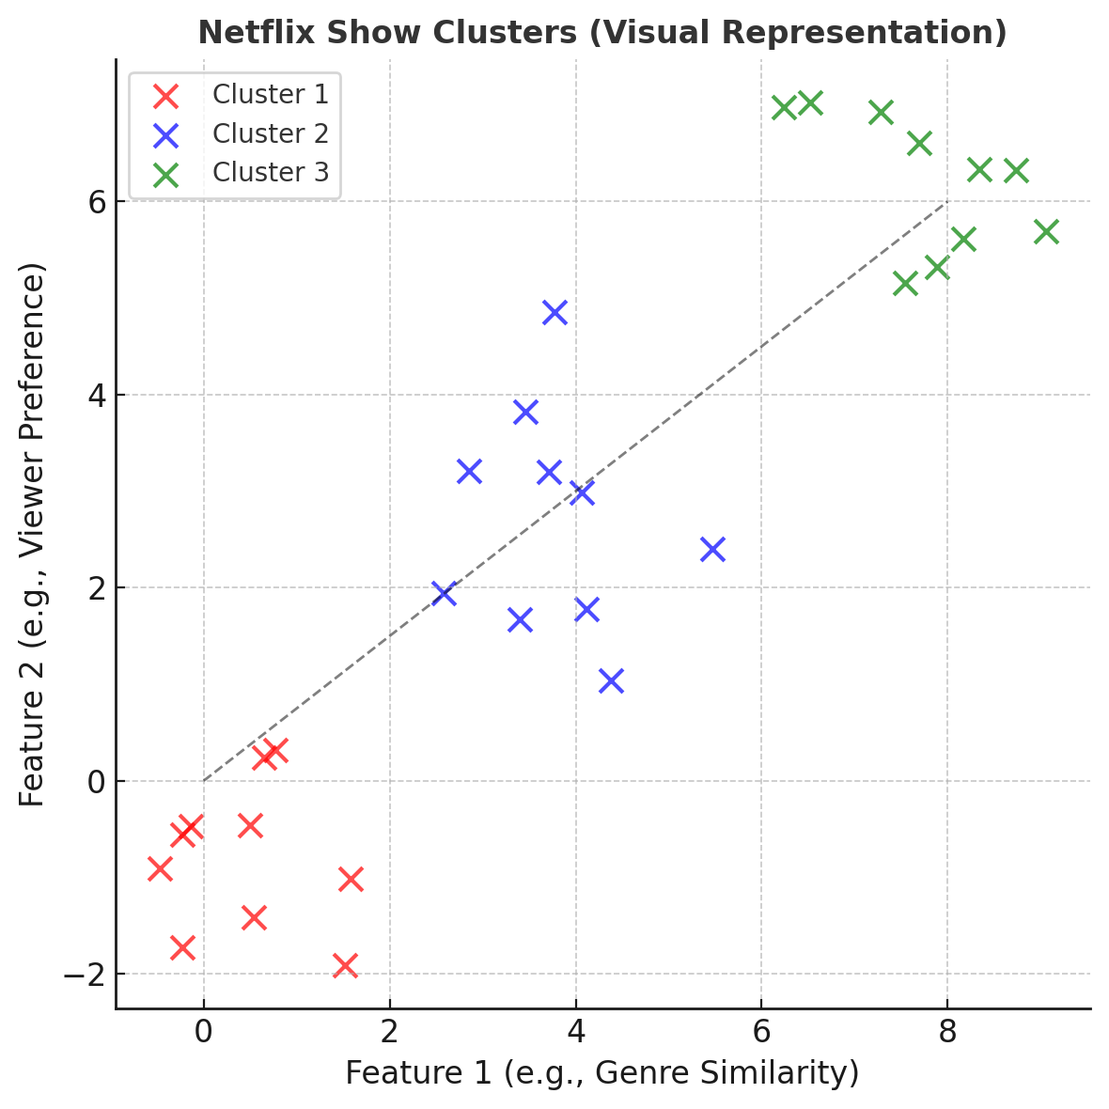
What is Clustering?
Clustering is an unsupervised ML technique that groups data points based on similarity.
In Netflix context → it groups shows by genre, rating, duration, keywords.
Helps identify hidden patterns and audience groups.

Slide 12


K-Means Clustering
Divides dataset into K groups where each group is similar internally.
Works on distance metrics like Euclidean distance.
Steps:
Choose number of clusters (K).
Assign shows to nearest cluster center.
Recalculate centroids → repeat till stable.
Example: Money Heist & Breaking Bad in same cluster (Crime-Thriller).

Slide 13
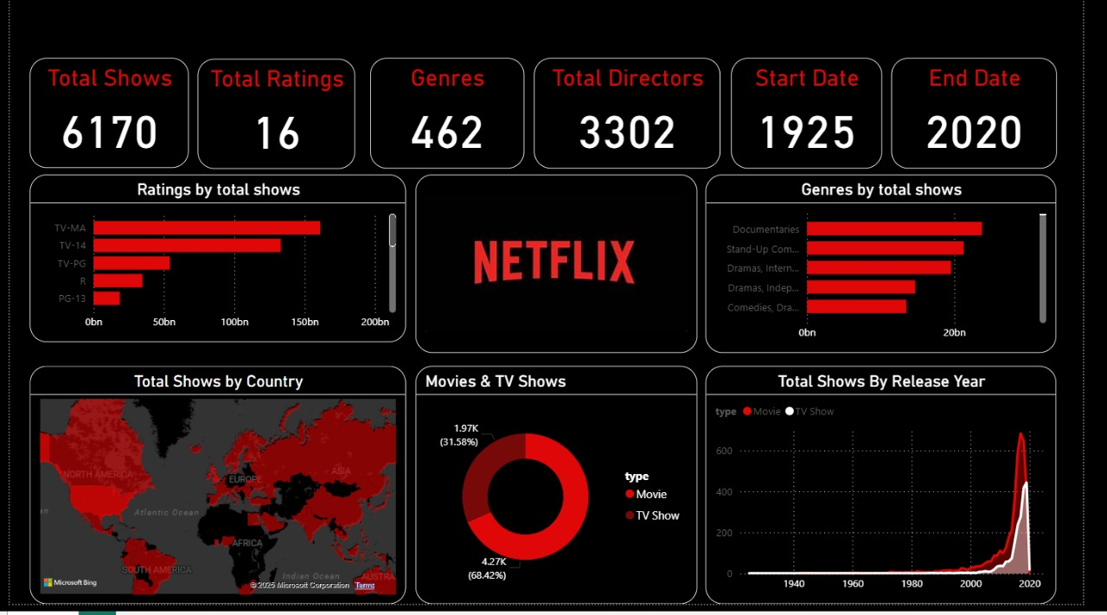

Slide 14
Hierarchical Clustering
Builds a tree of clusters (dendrogram).
Merges closest clusters step-by-step (bottom-up approach).
Doesn’t require pre-defined K value.
Helps visualize how genres & themes merge.

Slide 15
Future Scope
Real-time clustering using viewer behavior data.
Personalized suggestions for multi-user profiles.
Integration with gaming, interactive & live content.
Region-based recommendation and pricing models.
Predicting upcoming genre trends.

Slide 16
Conclusion
Clustering = key to personalized content delivery.
Reveals deep insights about Netflix’s diverse library.
Enhances viewer engagement & satisfaction.
Helps Netflix stay ahead in the streaming competition.

Slide 17
Power of Data. Power of Stories. – Netflix

